Slide 1

Chicago Cubs Statistics
By David Coleman

Slide 2
What is a database
Data is stored in columns
Each row is a new entry of information
Can be used store numbers and words
A collection of information stored on a computer we can access remotely

Slide 3
What is a database
Column are stored in related tables
Ex. name or phone number stored in a person table
Possible to join tables based on unique columns existing in both tables

Slide 4
Lahman’s data set
This database contains statistics for Major League Baseball from 1871 through 2021
Includes data from the two current leagues (American and National), the four other "major" leagues (American Association, Union Association, Players League, and Federal League), and the National Association of 1871-1875
Created by Sean Lahman
Contains:
Pitching
Hitting
fielding statistics
Player Salaries
Dominant player hand
Schools
Years Played

Slide 5

Chicago Cubs
The Chicago Cubs are an American professional baseball team based in Chicago.
part of the National League (NL) Central division
Throughout the club's history, the Cubs have played in a total of 11 World Series.

Slide 6
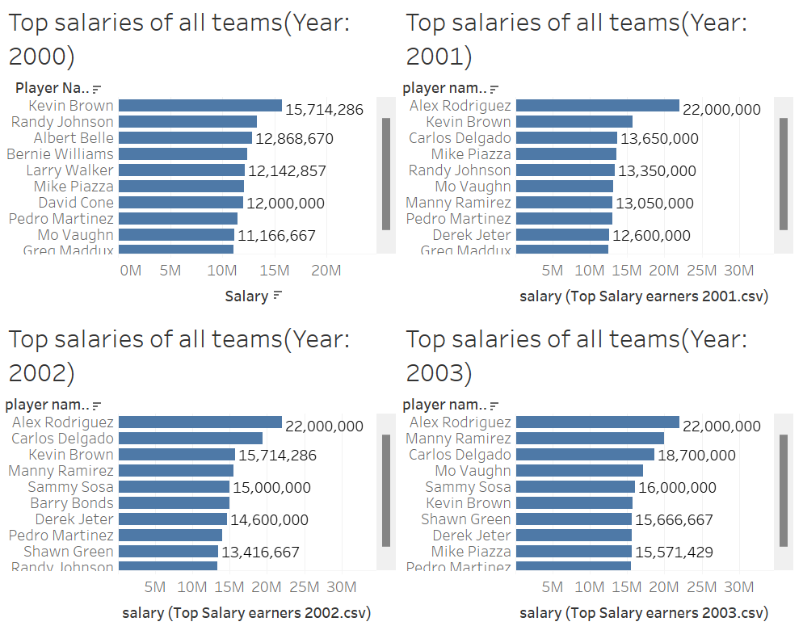
TOP Earning players of all teams

Slide 7
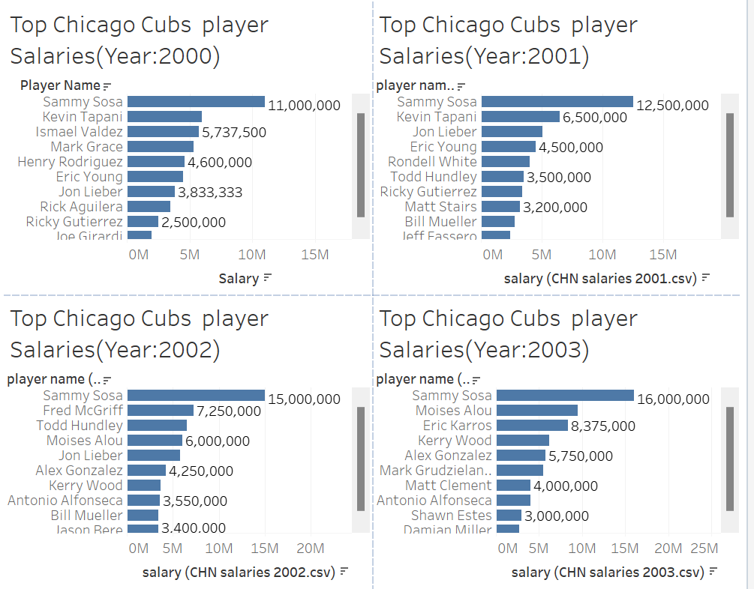
Top Chicago Cubs earnings
Sammy Sosa is the top earner for 4 years
Year 2000
11,000,000
Year 2001
12,500,000
Year 2002
15,000,000
Year 2003
16,000,000

Slide 8
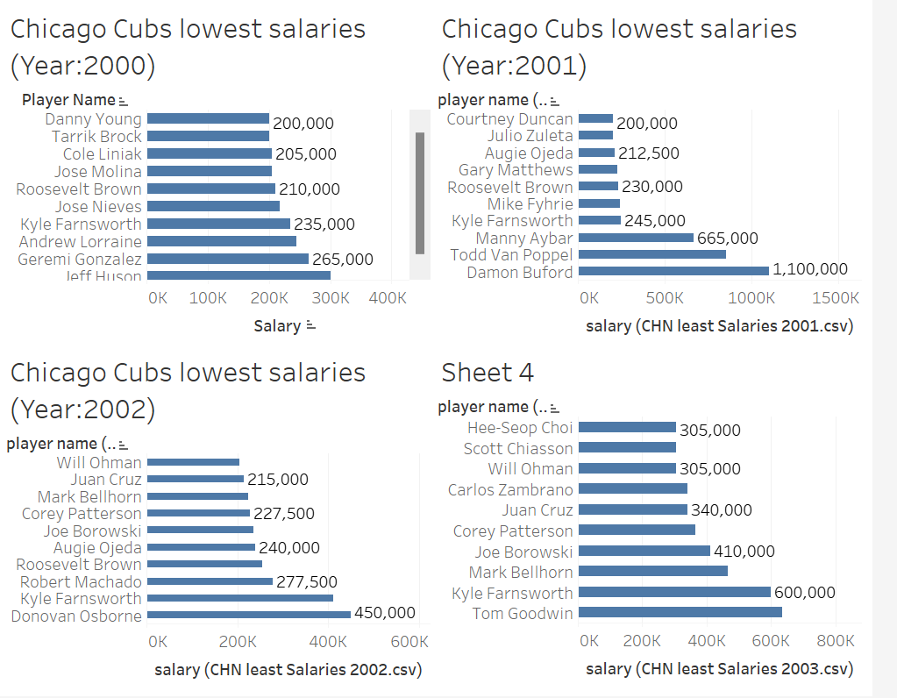
Lowest Chicago Cubs earnings
Year 2000
Danny Young - 200,000
Year 2001
Courtney Duncan 200,000
Year 2002
Will Ohman 203,500
Year 2003
Hee-Seop Choi 305,000

Slide 9
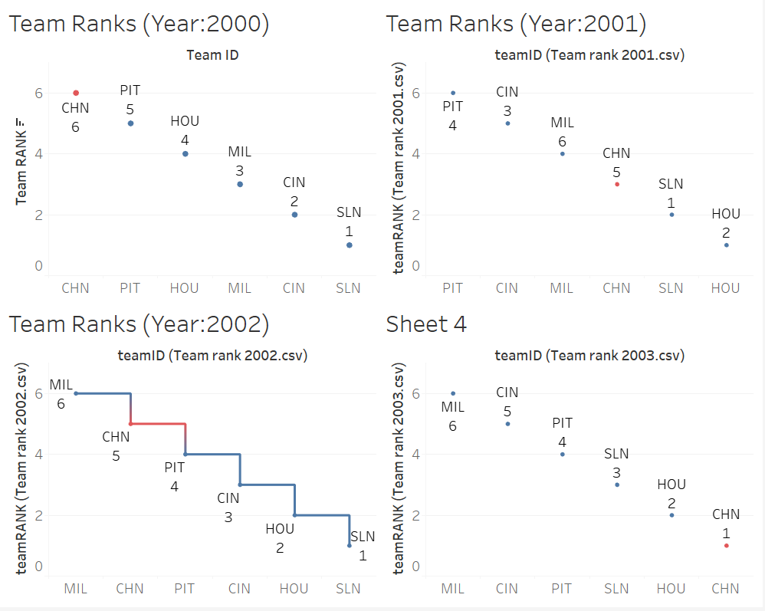
National League rankings(Central)

Slide 10
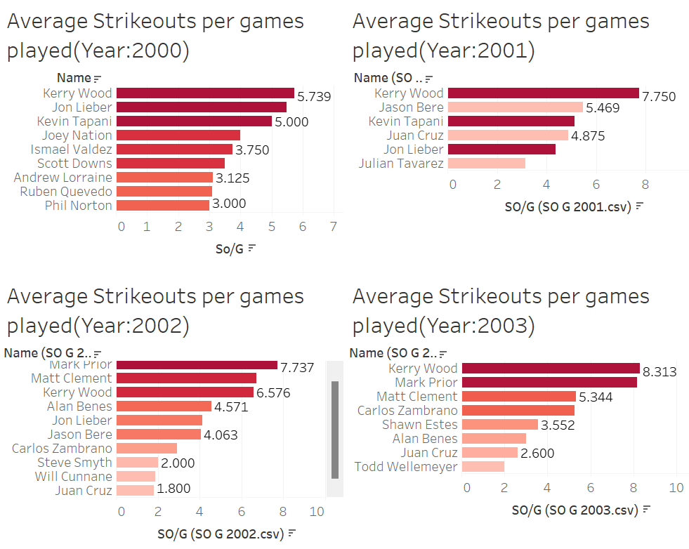
Average strikeouts per game SO/G
Players with at least a 3 average

Slide 11
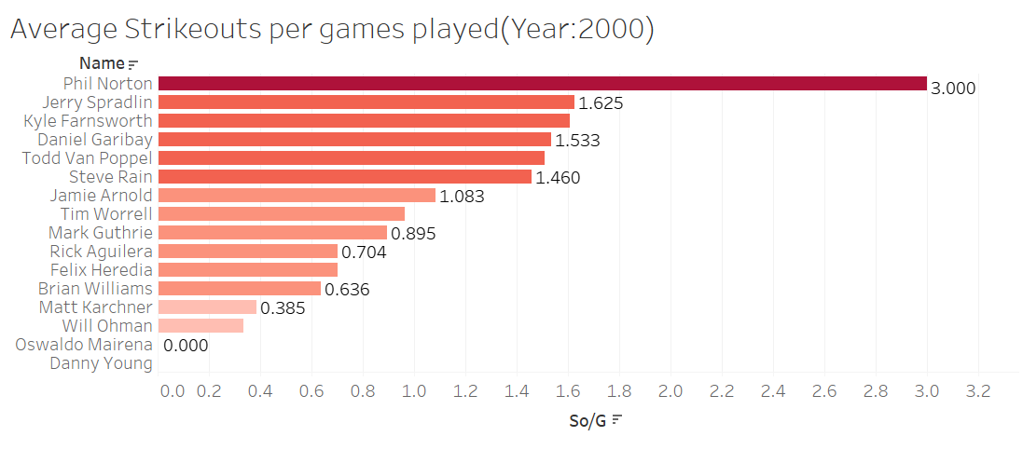
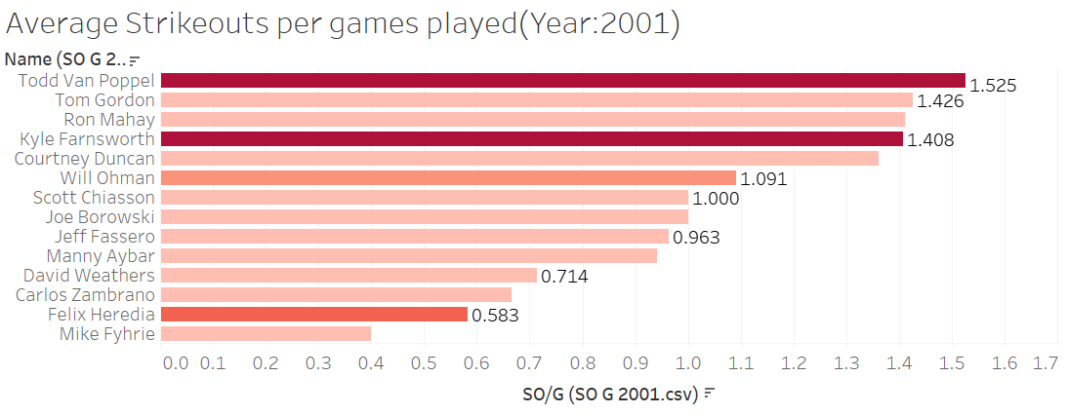
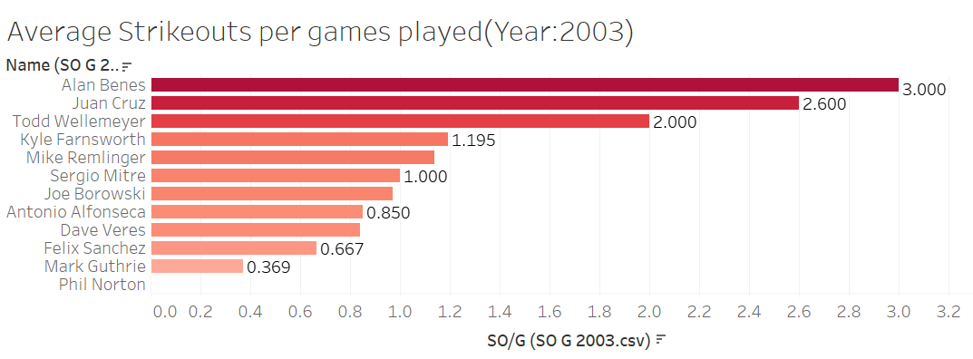
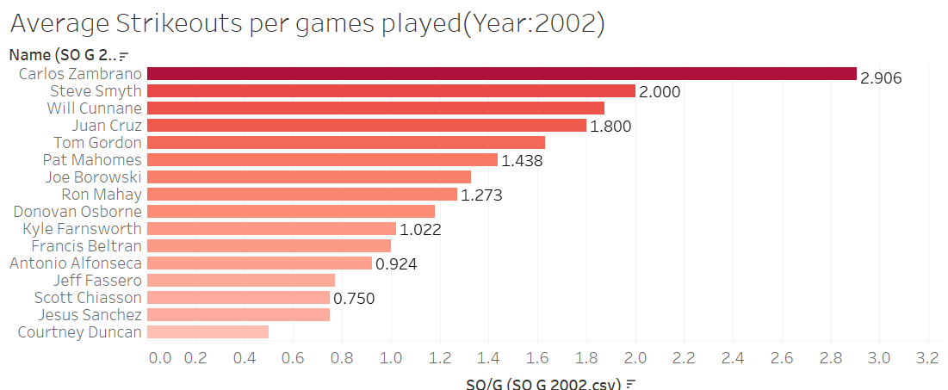
Average strikeouts per game SO/G
Players with at most a 3 average

Slide 12
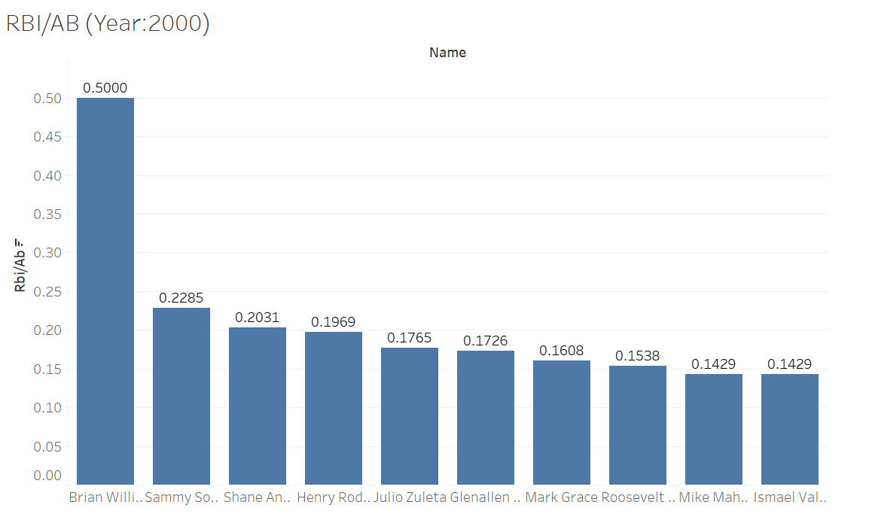
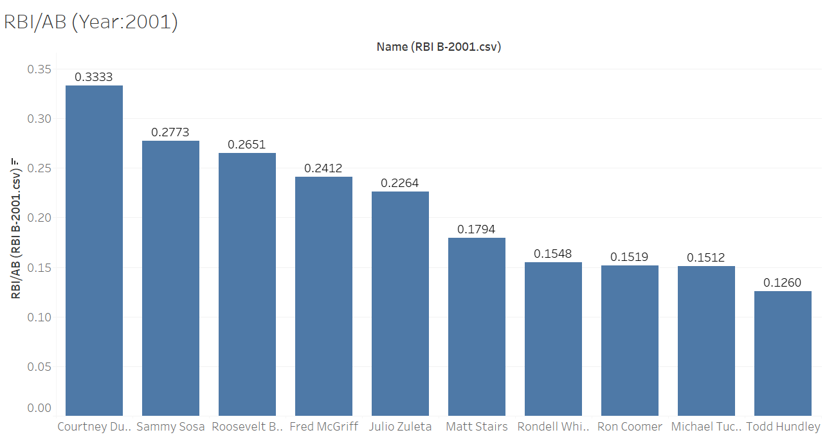
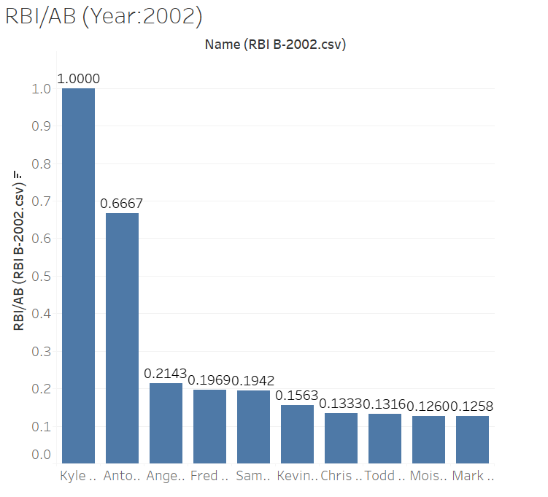
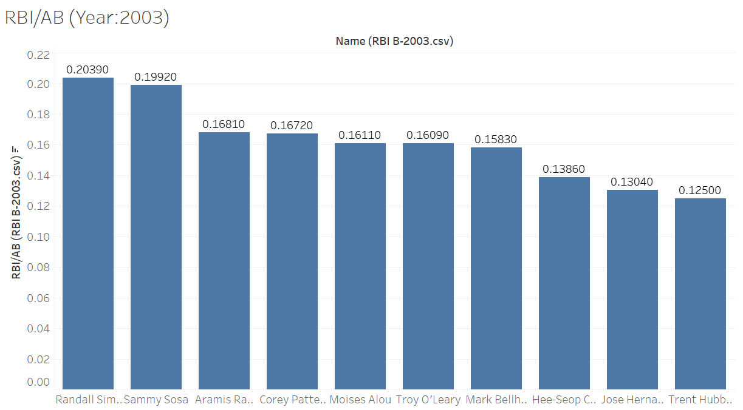
Best Offensive Batter-Team(Runs Batted In (RBI)/At-bat(AB) )

Slide 13
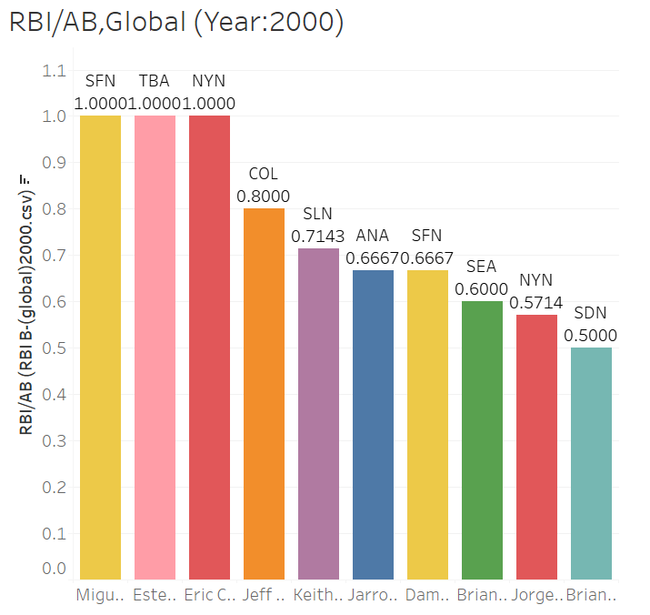
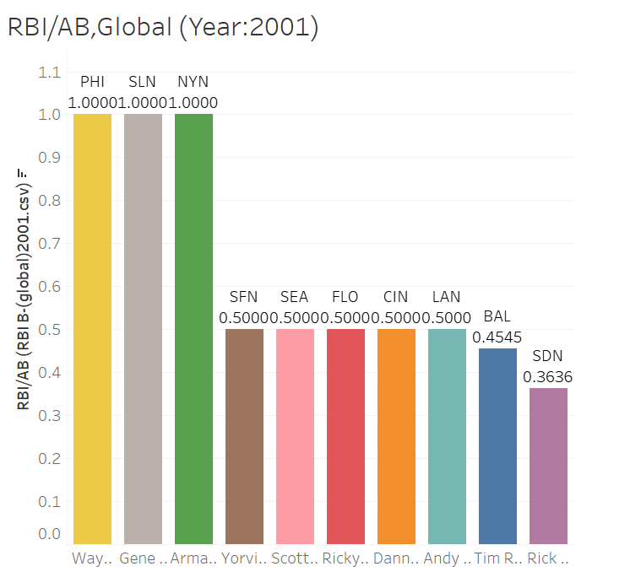
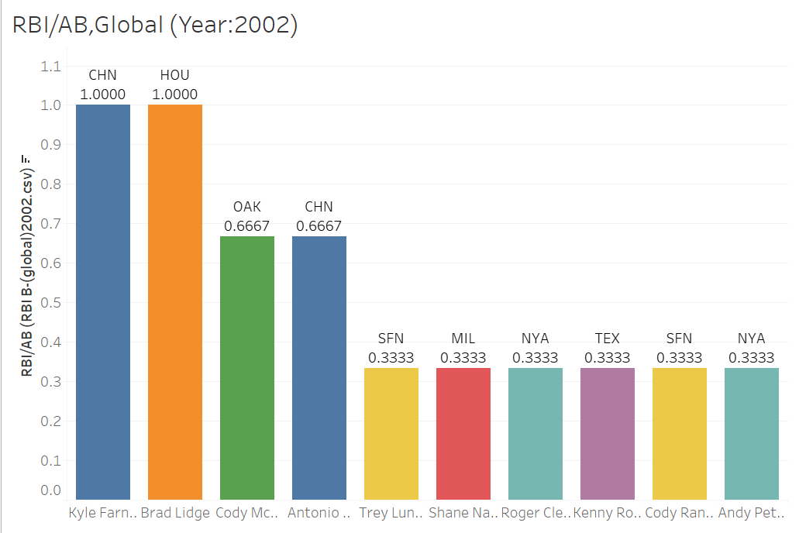
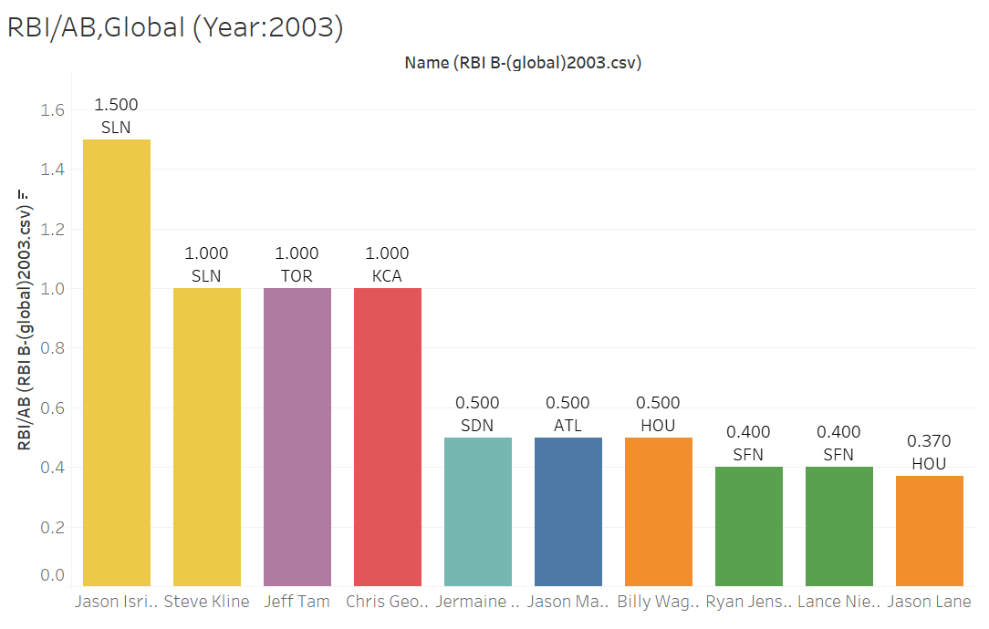
Best Offensive Batter-Global(Runs Batted In (RBI)/At-bat(AB) )

Slide 14
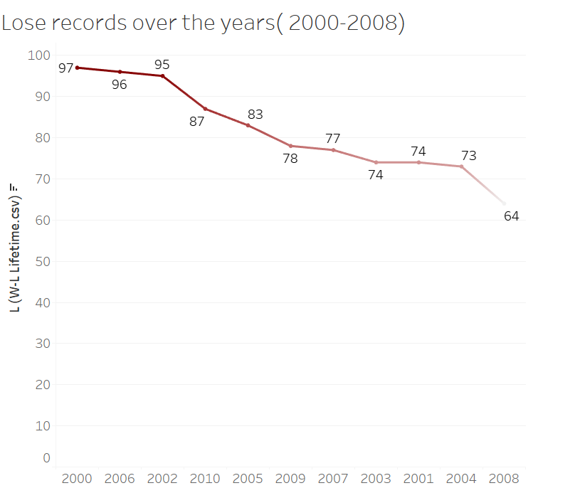
Lose records over the years

Slide 15
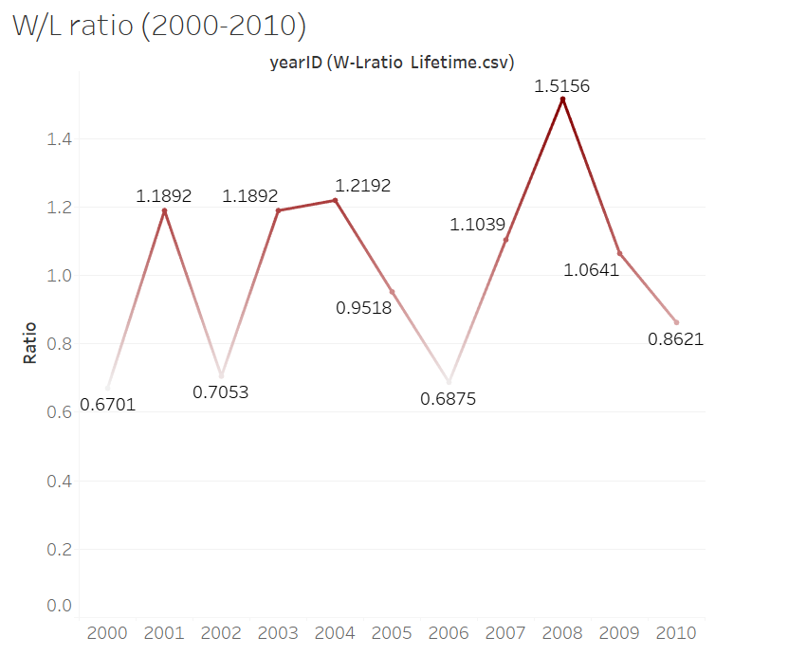
W/L 2000-2010

Slide 16
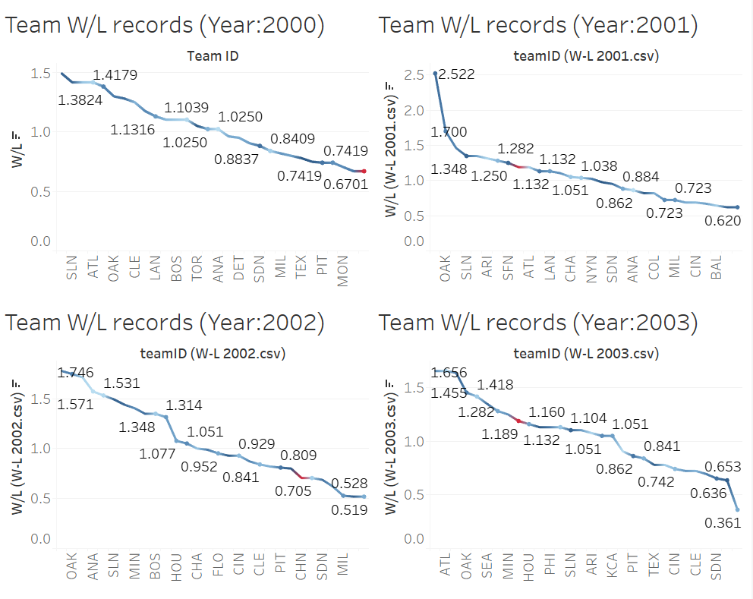
Win records over the years

Slide 17
Queries

Slide 18
Thank you for your time

